Slide 1

WEEK 9
CESAR A. PASCAL VASQUEZ

Slide 2
This week, I focused on finding a way to develop my web platform idea into a system where the user only needs to upload a trained model, and the simulation can then run directly on a G1 robot, with the goal of eventually supporting the R1 as well.

Slide 3
I also explored the design of the web interface to better visualize the final product. While the UI development is relatively straightforward, the main challenge is building an environment that can accept and run user-provided policies. This requires a robust backend structure, including a core execution pipeline and a model integration layer capable of handling different policy formats and ensuring compatibility with the simulation.

Slide 4
Here is a conceptual example of the final product I am aiming for: a web-based UI that allows users to select the robot model, load a policy, and choose the simulation environment. Additionally, the interface would provide real-time visualization of joint states and other relevant system variables.

Slide 5
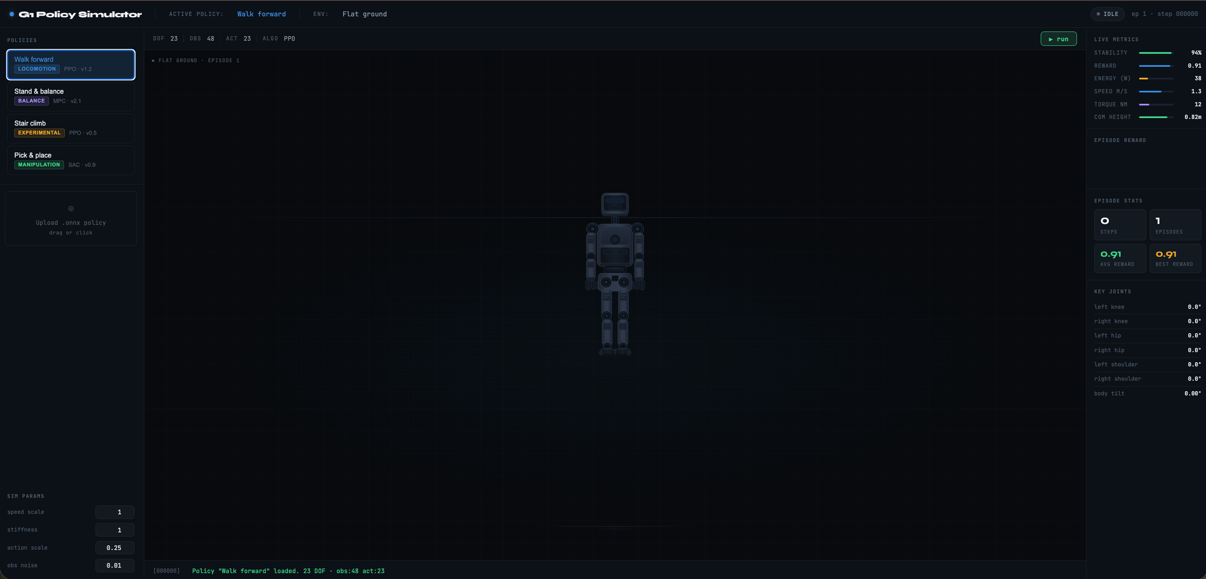

Slide 6
As discussed previously, executing the policy in the browser is relatively simple. The main challenge lies in mapping the policy outputs to the robot’s joints and ensuring proper visualization, particularly when handling multiple policies with potentially different structures.

Slide 7
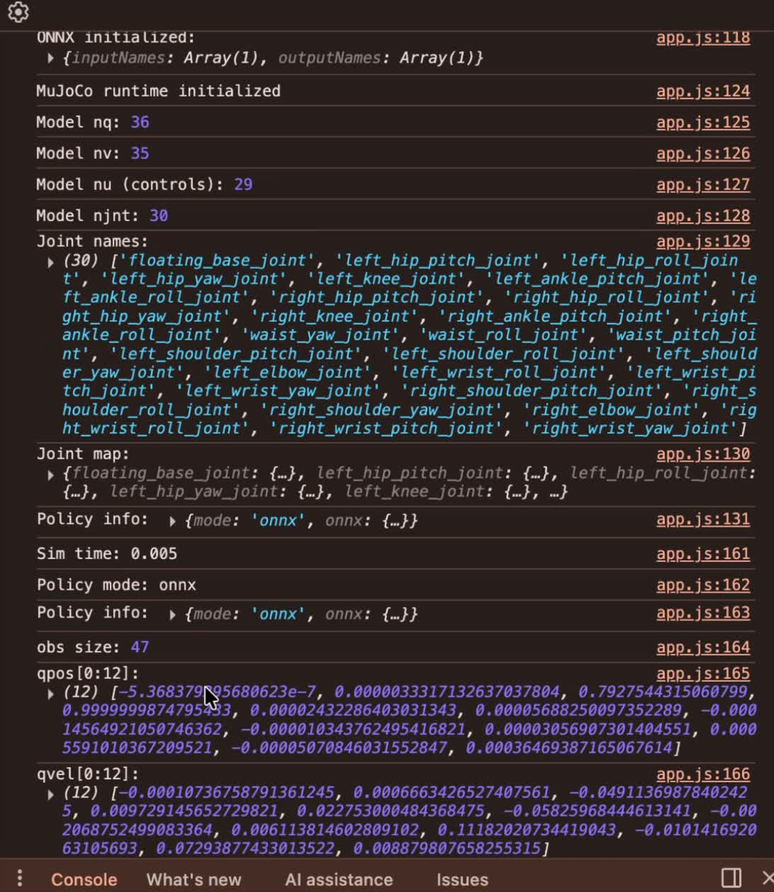
This demonstrates how policy outputs can be observed in real time via the browser console. The next step is to integrate these values into the UI to validate correct data flow and processing, before mapping them to the G1 model’s joints.

Slide 8
Next Steps
  Enable policy upload
  Allow users to upload trained policy files (e.g., ONNX).
  Run the policy in-browser
  Implement the basic execution pipeline.
  Validate inputs/outputs
  Ensure correct data handling and structure.
  Visualize values
  Display real-time outputs in the UI.
  Prepare for integration
  Map outputs to the G1 model after validation.

Slide 9
Reference
[1] Anthropic, Claude, large language model used for visual generation, 2026.

